Slide 1

Code Refactoring and Bug fixing
A. Renuka Sri

Slide 2
Task Summary
This task involves identifying and resolving bugs in a Flask web application. The provided Flask code and HTML template contain issues that hinder the proper functioning of the web application. The primary objective is to debug the code to ensure that the application functions correctly as intended.
The debugging process includes:
Identifying Bugs: Reviewing the Flask code and HTML template to identify potential issues or discrepancies that may cause the application to malfunction.
Bug Documentation: Documenting each identified bug and proposed debugging steps.
Debugging Code: Implementing necessary changes in the Flask code and HTML template to address the identified bugs and ensure proper functionality.
Testing: Verifying the modified code to ensure that the bugs have been successfully resolved and that the web application operates correctly.

Slide 3

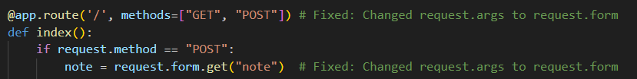
Bug and Debug Documentation
Bug 1: Incorrect Retrieval of Form Data
In the Flask code, the note variable is being retrieved from the request.args dictionary, which is used for query parameters in a GET request. However, the form is submitted using POST method, so the data should be retrieved from request.form instead.
Debugging:
Flask Code: Modify the note retrieval line to use request.form.get() instead of request.args.get().
Code after Debugging:
Flask Code: Update note retrieval to request.form.get("note").

Slide 4


Bug 2: Missing Form Submission Method in HTML
In the HTML template, the form action attribute is not set to the correct route, and the method attribute is missing, and the button element within the form does not have a type attribute specified, causing it to default to type="button" instead of type="submit“ defaulting the form submission to GET method.
Debugging:
HTML Template: Add method="POST" attribute to the form tag and set the action attribute to "/" to match the route defined in the Flask application.
Add type="submit" attribute to the button element to ensure it triggers form submission.
Code after Debugging:
HTML Template: Update the form action attribute to "/", and add method="POST".
Add type="submit" attribute to the button element.

Slide 5
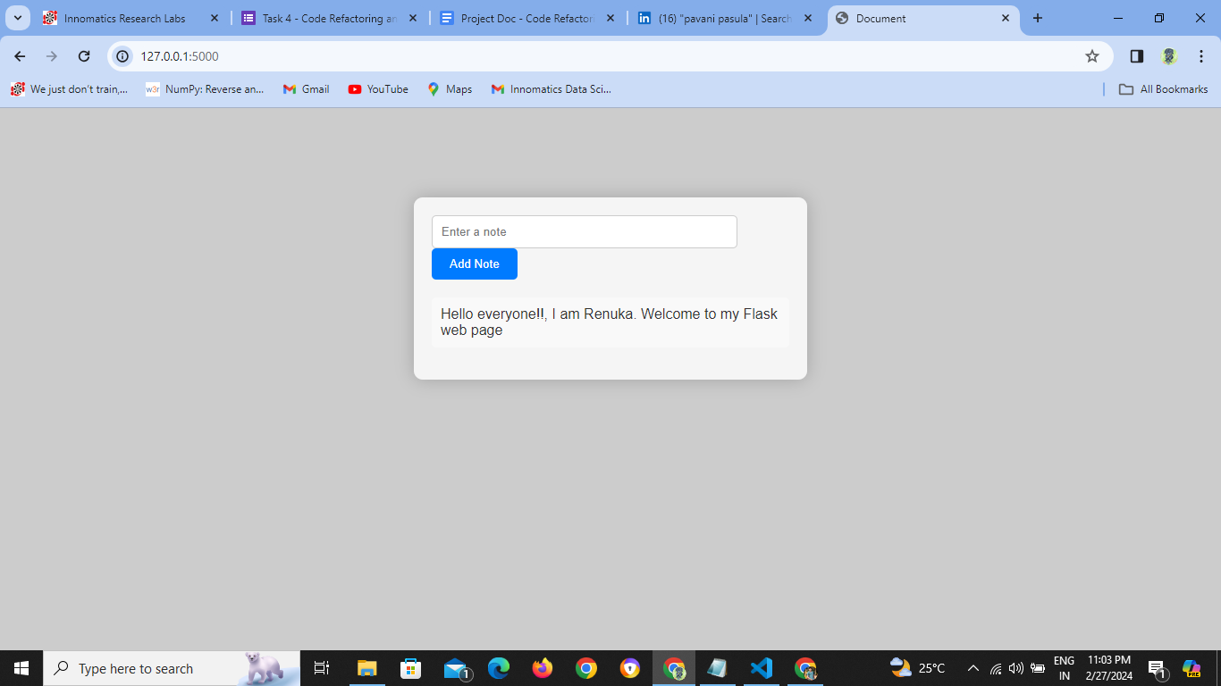
Flask web page after debugging

Slide 6

THANK YOU

